Slide 1
Computer Organization Principles
School of Software, Dalian University of Technology
Chi Lin (林驰)
chilin@mail.dlut.edu.cn

Slide 2
Chapter 3 Representing & Manipulating Information
Contents
Data Representation & Encoding
Integer Representations
Integer Arithmetic
Floating Point
Arithmetic Logical Unit (ALU)
Summery

Slide 3
Chapter 3 Representing & Manipulating Information
Contents
Data Representation & Encoding
Integer Representations
Integer Arithmetic
Floating Point
Arithmetic Logical Unit (ALU)
Summery

Slide 4
ALU Functionalities
Data Representations
ALU
Arithmetic
Calculations

Slide 5
ALU Definition
The ALU is that part of the computer that actually performs arithmetic and logical operations on data.
All of the other elements of the computer system—control unit, registers, memory, I/O—are there mainly to bring data into the ALU for it to process and then to take the results back out.

Slide 6
ALU Definition
An ALU and, indeed, all electronic components in the computer are based on the use of simple digital logic devices that can store binary digits and perform simple Boolean logic operations.

Slide 7
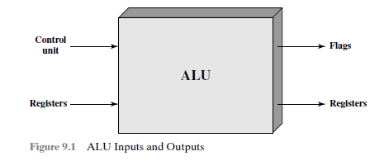
ALU Inputs and Outputs
Data are presented to the ALU in registers, and the results of an operation are stored in registers. These registers are temporary storage locations within the processor that are connected by signal paths to the ALU.

Slide 8
ALU Inputs and Outputs
The ALU may also set flags as the result of an operation. E.g., an overflow flag is set to 1 if the result of a computation exceeds the length of the register into which it is to be stored. The flag values are also stored in registers within the processor. The control unit provides signals that control the operation of the ALU and the movement of the data into and out of the ALU.

Slide 9
Chapter 3 Representing & Manipulating Information
Contents
Data Representation & Encoding
Integer Representations
Integer Arithmetic
Floating Point
Arithmetic Logical Unit (ALU)
Summery

Slide 10
Chapter Summery
Info
Data
File
…
Binary
Information
Representation and Storage
ALU
Integer Representation
Integer Arithmetic
Floating Points

Slide 11
Homework
Preview Chapter 3

Slide 12
Thank You

